Slide 1
RGUHS-ECHO India online training/ Education for COVID-19 Awareness Topic: Nurses preparedness Self-care and Courage in Pandemic Crisis
Prof. (Dr.) Zeanath Cariena J,
HOD, Department of Medical Surgical Nursing
Sri Devaraj Urs, College of Nursing
&
Chief Nursing Officer-
R.L. Jalappa Hospital & Research Centre Kolar

Slide 2
Nurses preparedness Self-care and Courage in Pandemic Crisis
Presentation Highlights
Nurses - Most challenging crisis,
Overcoming pandemic crisis by Building
Self-care
Courage
Spiritual wellbeing
Nurses preparedness - Changing the Way You Work” at;
Professional level,
Personal and Family level
Society level

Slide 3
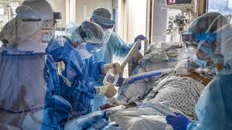
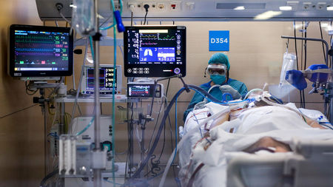
Nurses preparedness Self-care and Courage in Pandemic Crisis Nurses Frontline Warriors “lost themselves in the service of others”

Slide 4
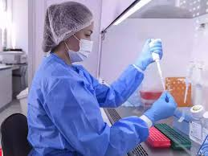
Nurses preparedness Self-care and Courage in Pandemic Crisis Basic to any philosophy of nursing seems to be these three concepts: 1. Reverence for the gift of life; 2. Respect for the dignity worth, autonomy & individuality of each human beings; 3. Resolution to act dynamically in relation to one’s beliefs –Ernestine Wiedenbach

Slide 5
Nurses preparedness Self-care and Courage in Pandemic Crisis
Most Challenging crisis
Physical challenges –fear of infection and death
Emotional,
Social- family apprehension and pressure
Spiritual,
Environmental,
Intellectual,
Occupational- loss of job,
Financial,

Slide 6
Nurses preparedness Self-care and Courage in Pandemic Crisis
Other challenges include
Acute shortage of health care workers because of quarantine,
Health care workers attrition,
Violence against health care workers,
Social isolation and stigma,
A shocking professional demands,
Long duty hours,
Increased load of work & long hours in PPE,
Shortage of PPE
Ethical dilemmas,
Family demands etc,

Slide 7
Nurses preparedness Self-care and Courage in Pandemic Crisis
Overcoming challenging crisis-
Building Self-care among Nurses
Self-care is any activity that we do deliberately in order to take care of our mental, emotional, and physical health.
Good self-care is key to improved mood and reduced anxiety.

Slide 8
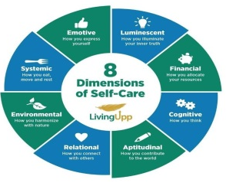
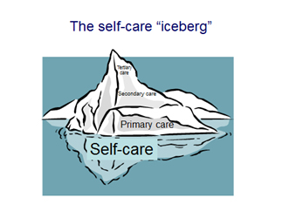
N Nurses preparedness Self-care and Courage in Pandemic Crisis
Self-care Dimensions

Slide 9
Nurses preparedness Self-care and Courage in Pandemic Crisis
Types Self-care Dimensions
Help you reach Highest potential in crisis situations.
1. Systemic Dimension of Self-Care -Physical health, Habits around eating, Exercising and Sleeping.
Feel alive.
2. Emotive Dimension of Self-Care
Communication Skills, Triggers, Response to what’s happening around you.
Peace and calm.

Slide 10
Nurses preparedness Self-care and Courage among Nursing Pandemic Crisis
Types Self-care Dimensions
3.Luminescent Dimension of Self-Care
Illuminate Your Inner Truth, Personal Brand, Your Unique, Strengths and Gifts, Spiritual Nature, Values, Personality, and Individual preferences. Uniquely YOU.
Confidently and unapologetically.
4. Financial Dimension of Self-Care
Allocate your resources, Fiscal fitness, how you earn, Spend, Give, Save, and Manage your finances.
Living Right Now, and Prepare for the one you’re Creating.

Slide 11
Nurses preparedness Self-care and Courage among Nursing Pandemic Crisis
Types Self-care Dimensions
5. Cognitive Dimension of Self-Care
How You Think, Your Thoughts, Your Mindset and Beliefs.
You'll focus your attention on what you want, rather than what you don’t want.
6. The Aptitudinal Dimension of Self-Care
Your Contribution To The World, Your Life’s Purpose, What you are uniquely suited to do in this world.
Meaningful contribution to the world.

Slide 12
Nurses preparedness Self-care and Courage in Pandemic Crisis
Types Self-care Dimensions
7. Relational Dimension of Self-Care
how you connect with others, you’ll explore your personal relationships, friendships, partnerships, and family relationships.
Create healthier connections mutually beneficial and respectful.
8. Environmental Dimension of Self-Care
How you harmonize with nature, interact with the world around, engage within your community, the environmental impacts of your decisions,
More grounded and connected to the world around you.

Slide 13
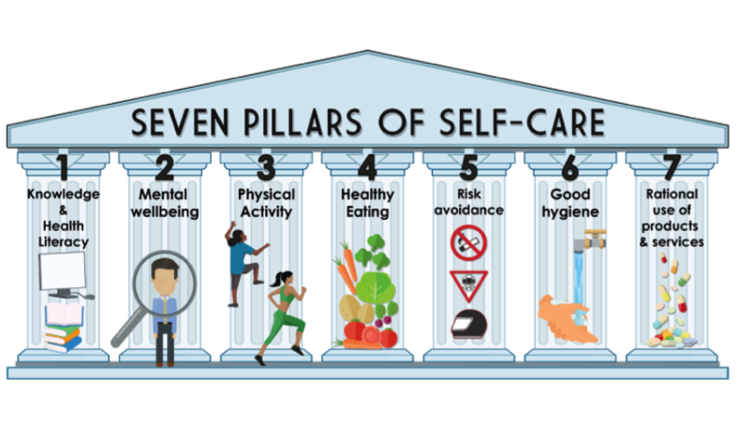
Nurses preparedness Self-care and Courage in Pandemic Crisis
Key points in boosting Self-care
As your reward is awaited

Slide 14
Nurses preparedness Self-care and Courage in Pandemic Crisis
Overcoming challenging crisis-
Building Courage- among Nursing Team
"Courage doesn't always roar. Sometimes courage is the little voice at the end of the day that says, 'I'll try again tomorrow.'“
Mary Anne Radmacher

Slide 15
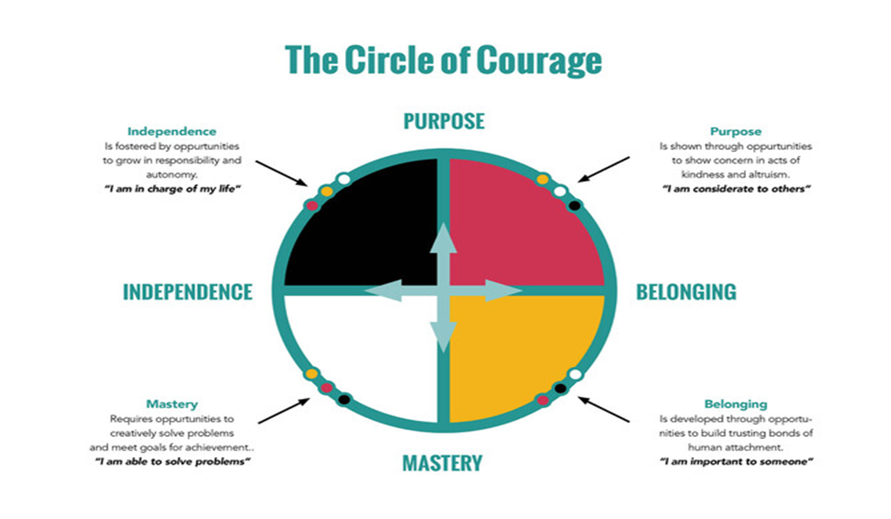
Nurses preparedness Self-care and Courage in Pandemic Crisis
Strategies of Courage

Slide 16
Nurses preparedness Self-care and Courage in Pandemic Crisis
Circle of courage
CONCEPT | FOCUS | Outcome – Courage
Purpose | Shown through opportunities to show concern in acts of kindness and altruism | “I am considerate to others”
Belonging | Developing through opportunities to build trusting bonds human attachments | “I am important to some one”
Mastery | Opportunities to creatively solve problems to meet goals for achievements | “I am able to solve problems”
Independence | Fostered by opportunities to grow in responsibility and autonomy | “I am in-charge of my action”

Slide 17
Nurses preparedness Self-care and Courage in Pandemic Crisis
Overcoming challenging crisis-
Spiritual Wellness
Explore your inner self. Take time to think about who you are?
Spend time meditating
Practice acceptance.
Be curious- take a moment to explore the experience a little deeper.
Look for a religious faith that you agree with.

Slide 18
Nurses preparedness Self-care and Courage in Pandemic Crisis
Strategies in implementation of self-care and courage by nurses
“Changing the Way You Work”
- Professional level
“Changing the Way You See your Work”
- Personal and Family level
“Changing the Way You be after Work”
-Society level

Slide 19
Nurses preparedness Self-care and Courage in Pandemic Crisis
STRATEGIES OF SELF CARE AT PROFESSIONAL LEVEL
Train and retrain
Establish a scientific reasonable shift schedule,
Adhere to infection control
Seek Psychological counselling,
Avoid unnecessary contacts,
Maintain good physical mental social and emotional stability,
Balance between work and family,

Slide 20
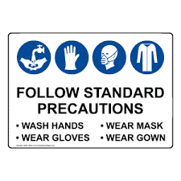
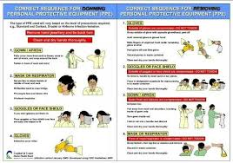
Nurses preparedness Self-care and Courage in Pandemic Crisis
At Professional level.
“Changing the Way You Work”

Slide 21
Nurses preparedness Self-care and Courage in Pandemic Crisis
“Changing the Way You See your Work”
At personal and Family level
Everything is not equally important. Do fewer things and do them well.
Decide what your values are — and which ones take precedence.
Focus on the things only you can do.
Do the important things which must be done now.

Slide 22
Nurses preparedness Self-care and Courage in Pandemic Crisis
“Changing the Way You be after Work”
At Society level
Communicate that support mental and psychological wellbeing in different target groups,
Be empathetic to all the affected covid-19,
Do not refer to people with covid-19 cases as “victims”
Minimize watching, reading, listening news about covid-19,
Protect yourself and be supportive to others,
Find opportunity to amplify positive and hopeful stories,
Take care of yourself,
Avoid unhelpful strategies,
Stay connected with the family,
Be counselled,
Ensure good communication’
Give care to vulnerable team

Slide 23
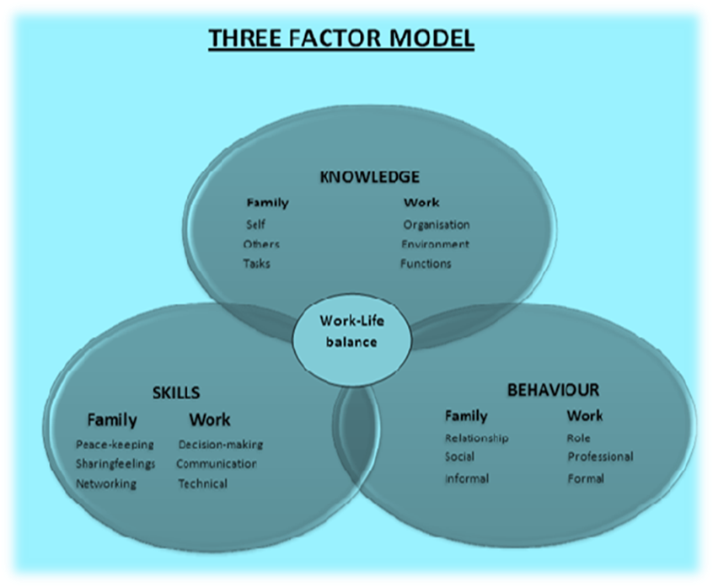
Nurses preparedness Self-care and Courage in Pandemic Crisis
Balance between work and family safety
Knowledge | Family | Work
 | Self, others, tasks | Organisation, environment, functions
Behavior | Informal Social relationships, | Formal roles, professional integrity,
Skill | Peace keeping, sharing feelings, networking. | Decision making, technical expertise, communication

Slide 24
Nurses preparedness Self-care and Courage in Pandemic Crisis Take Home Message – Lets Pledge to:- Reverence, Respect make Resolution for the gift of life & act dynamically in relation to one’s beliefs in COVID -19 Pandamic

Slide 25
Thank you

