Slide 1
All about phase-3 vaccination in Karnataka
Dr. Lokesh Alahari
Sub-Regional Team leader-Karnataka
WHO India-NPSP

Slide 2
COVID-19 vaccination – Karnataka
COVID-19 vaccination was launched on 16th January 2021
  Phase 1: Health care workers and Frontline workers
  Phase 2: Persons aged above 60 years and Persons aged above 45 years
  Phase 3: Persons aged 18 to 44 years
COVID-19 vaccination strategy has been formulated as per guidance of National Expert Group on COVID-19 vaccination (NEGVAC)
Three vaccines have received EUL in India:
  Covishield, Covaxin and Sputnik V
  Two-dose schedule
  The vaccines are not interchangeable: A beneficiary must complete vaccination schedule using same vaccine product
  Storage temperature for these vaccines similar to other UIP vaccines (+2 to +8 deg C)

Slide 3
COVID-19 vaccine doses administered as on 10th May 2021
Category | Dose | National Coverage | Karnataka Coverage
Health care workers | 1st Dose | 95,63,406 | 6,92,052
 | 2nd Dose | 65,05,072 | 4,49,495
Frontline Workers | 1st Dose | 1,40,49,681 | 4,64,198
 | 2nd Dose | 78,51,075 | 1,80,771
Age Group 18-44 Years | 1st Dose | 25,52,843 | 21,485
Age Group 45 to 60 years | 1st Dose | 5,54,97,658 | 37,29,958
 | 2nd Dose | 71,73,939 | 4,80,596
Over 60 years | 1st Dose | 5,38,00,706 | 35,93,232
 | 2nd Dose | 1,56,39,381 | 10,18,951
Total |  | 17,26,33,761 | 1,06,30,738

Slide 4
GOI fast tracks Emergency Approvals for foreign produced COVID-19 Vaccines that have been granted EUA in other countries to Expand the Basket of Vaccines for Domestic Use and Hasten the Pace and Coverage of Vaccination
13 APR 2021
The NEGVAC, after comprehensive deliberation, recommended that vaccines for COVID-19, which have been developed & are being manufactured in foreign countries and which have been granted emergency approval for restricted use by USFDA, EMA, UK MHRA, PMDA Japan or which are listed in WHO (Emergency Use Listing) may be granted emergency use approval in India, mandating the requirement of post-approval parallel bridging clinical trial in place of conduct of local clinical trial as per the provisions prescribed under Second Schedule of the New Drugs & Clinical Trials Rules 2019.
Further, the first 100 beneficiaries of such foreign vaccines shall be assessed for seven days for safety outcomes before it is rolled out for further immunization programme within the country.

Slide 5
Phase 3 Vaccination
MoHFW-GOI has issued the Liberalized Pricing and Accelerated National Covid-19 Vaccination Strategy for further accelerating the pace of COVID-19 vaccination.
The cohort of eligible beneficiaries has been expanded with inclusion of citizens aged 18 years to 44 years, for vaccination
It will continue to be mandatory for all Government and Private COVID Vaccination Centers (CVCs) to register on the Co-WIN system, regardless of the source of vaccine doses
It shall also be mandatory for all CVCs to record all vaccinations, issue digital vaccination certificates and to report all AEFIs on the Co-WIN system

Slide 6
Registration of COVID Vaccination Center (CVCs)
The eligibility conditions for any health facility for registration as a CVC also remain unchanged.
There will be no need for the existing private CVC, which is already on Co-WlN, to re-register on the COWIN system
For any Private Health Facility to be operated as a CVC, the facility must have the following:
  Sufficient Cold Chain equipment and capacity: Exclusive Refrigerator or ILR for vaccines
  Sufficient rooms/space for waiting area, vaccination and observation post vaccination.
  Sufficient number of trained vaccinators and verifiers
  Ability to manage the Adverse Events Following Immunization (AEFI), as per the norms
  and guidelines of the Ministry.

Slide 7
Registration of Industrial Establishment CVCs
Wherever an Industrial Establishment has a hospital that is eligible for registration as a CVC as per the eligibility conditions mentioned previously such industrial establishment hospital can be registered on Co-WlN as an Industrial Establishment CVC.
The Industrial Establishments without such suitable hospital may be registered as an Industrial Workplace CVC, with mapping to any other existing private CVC.
For inclusion of new non-empaneled private CVC or industrial/office CVC, a request has to be sent to State control room/ DD-immunization (ddimmkar@gmail.com) for approval. District RCHO should ensure that request should be sent only for facilities eligible as per the criteria specified
State shall communicate the approval status within 2 days
Once approved, registration of CVCs, on the Co-WIN system, will done by district RCHO

Slide 8
Procurement of vaccine doses and declaration of stocks and prices
The private hospitals and industrial establishments (through their hospitals), willing to provide vaccination services, may procure vaccine doses from the manufacturers
Government will not be issuing vaccines to private CVCs from May 1st onwards.
Each private CVC, including the already registered CVCs, must declare on Co-WIN, the vaccine type(s), the stocks of \vaccines and the prices decided by the CVC to be charged to the citizens, for vaccination services being offered 1st May 2021 onwards.
As per Government of Karnataka notification, private CVC can charge maximum service charge of Rs:100 per dose apart from cost of vaccine.

Slide 9
Procurement of vaccine doses and declaration of stocks and prices
The vaccine types and theirs prices will be displayed in the “Appointments” module on Co-WIN so that the citizens can make an informed choice at the time of booking a vaccination appointment.
The private CVCs will be able to populate their schedule for offering appointment slots for citizens only after the requisite information .i.e. the vaccine type(s), the stocks of \vaccines and the prices has been declared on Co-WIN.
All vaccination slots at private CVCs will continue to be offered only for online appointment from Co-WlN or Arogya setu.
On-site/walk-in registration/appointments will be allowed only, if any doses are left in the last opened vial(s) so as to minimize vaccine wastages.
The provisions of online appointment will not be applicable to Industrial Establishment CVCs and workplace CVCs when these CVCs are operated exclusively for a defined group (for example for employees of an industrial establishment etc.).

Slide 10
COVID-19 vaccination for 18-44 age group
Karnataka
Hon’ble Chief Minister of Karnataka has symbolically launched vaccination for 18 to 44 years through state procured vaccines on 1st May 2021 at Bengaluru
Estimated population of 18 to 44 years in the state is 3.26 crore. Total estimated vaccine doses required will be 6.52 crores
Karnataka has placed initial order for 2 crore doses of Covishield and 1 crore doses of Covaxin towards vaccination of 18 to 44 years population in the state.
For age group of 44+ years, Government of India will continue to supply vaccines free of cost to the state. Vaccination for 44+ will be done free of cost at all Government COVID-19 vaccination centers.

Slide 11
COVID-19 vaccination for 18-44 age group
Karnataka
As provided in the GOI Strategy Document, all priority groups, such as the Health Care Workers, the Front-Line Workers and citizens above aged 45 years or more (as on 01.01.2022), shall continue to be eligible for vaccination
  Free of cost from the Government CVCs; or
  On payment from the private CVCs.
Citizens in the age group of 18 years to 44 years:
  Free of cost from the Government CVCs; or
  on payment from the private CVCs.
Vaccination for 18 to 44 age group will be done for online registered beneficiaries and online appointment booking only. No Walk-in allowed on Co-WIN

Slide 12
Registration and appointment of expanded cohort (18-44 years)
Registration:
Registration of citizens in 18-44 age group started with only online registration on CO-WIN from 28.04.2021 (Wednesday) onwards.
Online appointment booking
The online appointment facility is also being offered from for such citizens for booking appointments for sessions and slots available on Co-WlN for vaccination from 01.05.2021 onwards
https://selfregistration.cowin.gov.in/

Slide 13
COVID-19 vaccination for 18-44 age group
Government CVCs
Government of Karnataka has initiated vaccination for 18 to 44 age group from 10th May onwards in all the districts
Initially, vaccination for this age group will be implemented in all major hospitals of Bangalore; namely KCG, Jayanagar General Hospital, Sir C.V. Raman General hospital, Government Medical Colleges and Central Government Institutions like ESI Hospitals and NIMHANS
In all other districts, it is planned to start vaccination in district hospitals, Government Medical Colleges and all Taluka Hospitals.
Each Covid Vaccination Centre conducting Covid Vaccination for 18 to 44 age group will have an exclusive/separate session site earmarked for these beneficiaries
Each session to plan 100 to 150 appointments per day
Appointments being scheduled for 7 days in advance for next 7 days.
Number of session sites created for this purpose will be based on vaccine availability and as and when more vaccines become available more sessions will be opened up.

Slide 14
COVID-19 vaccination Certificate
Covid-19 vaccination certificate can be downloaded anytime from https://selfregistration.cowin.gov.in/. OTP authentication will be done through mobile number used during vaccination
For all future references, as proof of COVID-19 vaccination, only Co-WIN generated, digitally verifiable vaccination certificate will be valid

Slide 15
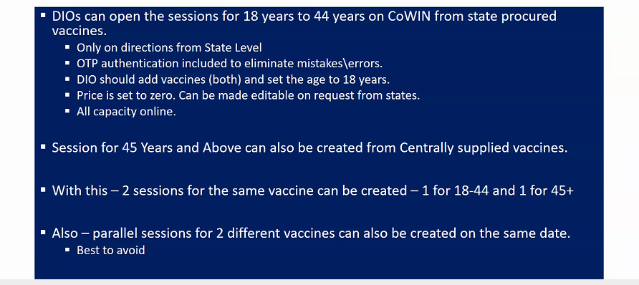
Provisions in Co-WIN For Phase 3 (Govt CVC)

Slide 16
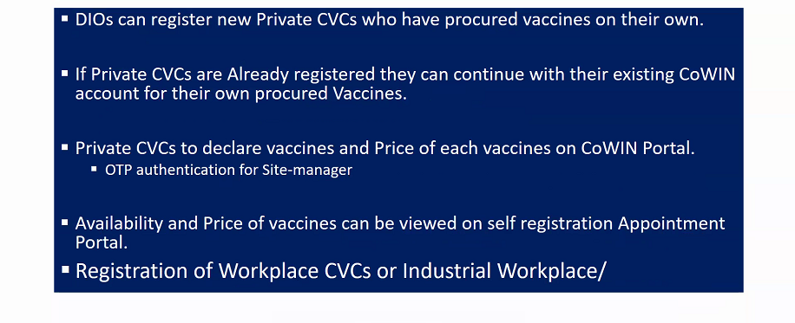
Provisions in Co-WIN For Phase 3 (Private CVC)

Slide 17
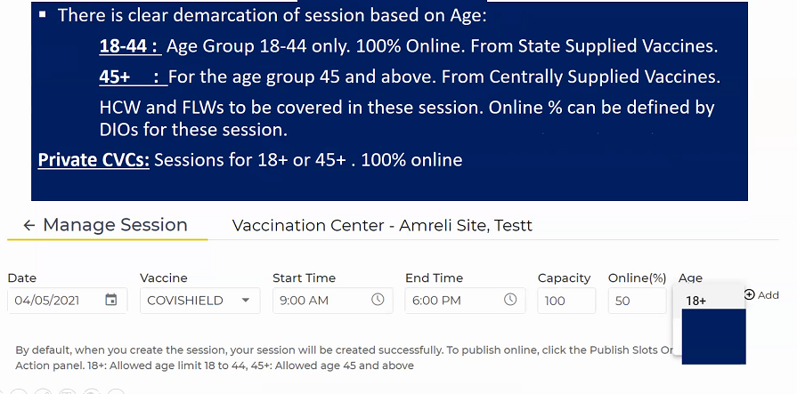
Important Note: Session Management

Slide 18
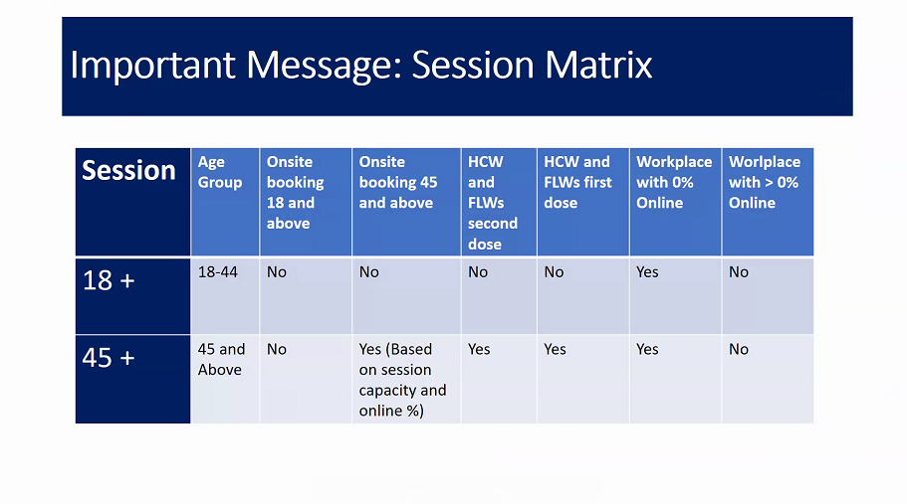

Slide 19
New features and upgrades
With the provision of registration for 18 years and above citizens on COWIN Portal. Following new utility is incorporated on CoWIN Portal:
Updating Category and Sub Category of CVCs and Workplace on CoWIN Portal.
Declaring Minimum Age and Vaccine Price by Private CVCs.
Declaring Minimum Age and Vaccine by DIOs for Government CVCs.
Creating session for 18-44 age
Self-Registration for 18 years and above and appointments.

Slide 20
3) Declaring Minimum Age and Vaccine by Government CVCs.
District Immunization Officer/CVC Manager can login to CoWIN Portal and Navigate to “Vaccination Centres” Tab.
Under “Actions” option, DIO / CVC Manager can click on Setting Icon to update Minimum Age for the Session followed by Selecting Vaccine.
DIO/ CVC Manager can click on Manage Sessions under Actions Tab to Create and Publish the session.
CVC Manager can create session for multiple Vaccines on same day.

Slide 21
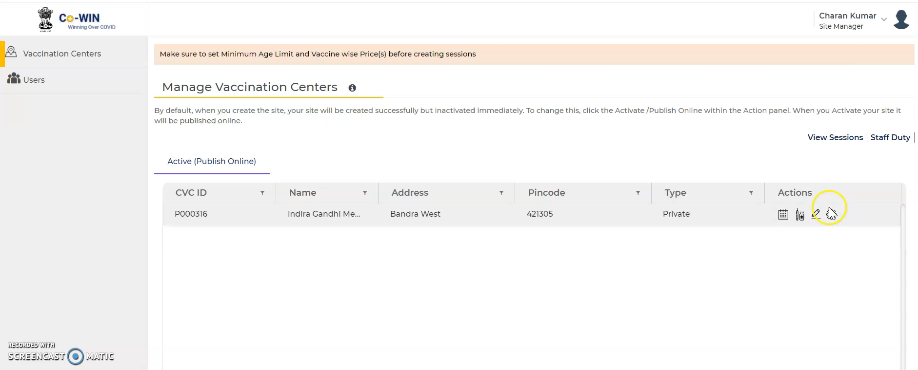
Declaration of age, vaccine and prices by Private CVCs

Slide 22

Creation and publication of sessions by Private CVCs

Slide 23
Documents Required for vaccination
All Persons should bring Photo ID (Any one of below)
    Aadhar card
    Election ID (EPIC)
    Passport
    Driving License
    PAN card
    National Population Registry (NPR) smart card
    Pension document with photograph
For Healthcare workers and frontline workers: Official Identity Card/ Employment certificate

Slide 24
SOPs on COVID-19 Vaccination of Persons without prescribed Identity Cards through Co-WIN
6th May 2021: MoHFW GOI
Such groups of people include nomads (including sadhu/ saints from various religions), prison inmates, inmates in Mental Health Institutions, citizens in Old Age Homes, road-side beggars, people residing in rehabilitation centres/camps, and other identified eligible persons aged 18 years or more, and not having any of the seven prescribed individual Photo ID Cards.
The CoWIN system will provide the facility for creation of special vaccination sessions for this purpose.
Government of Karnataka will provide detailed SoP soon

Slide 25
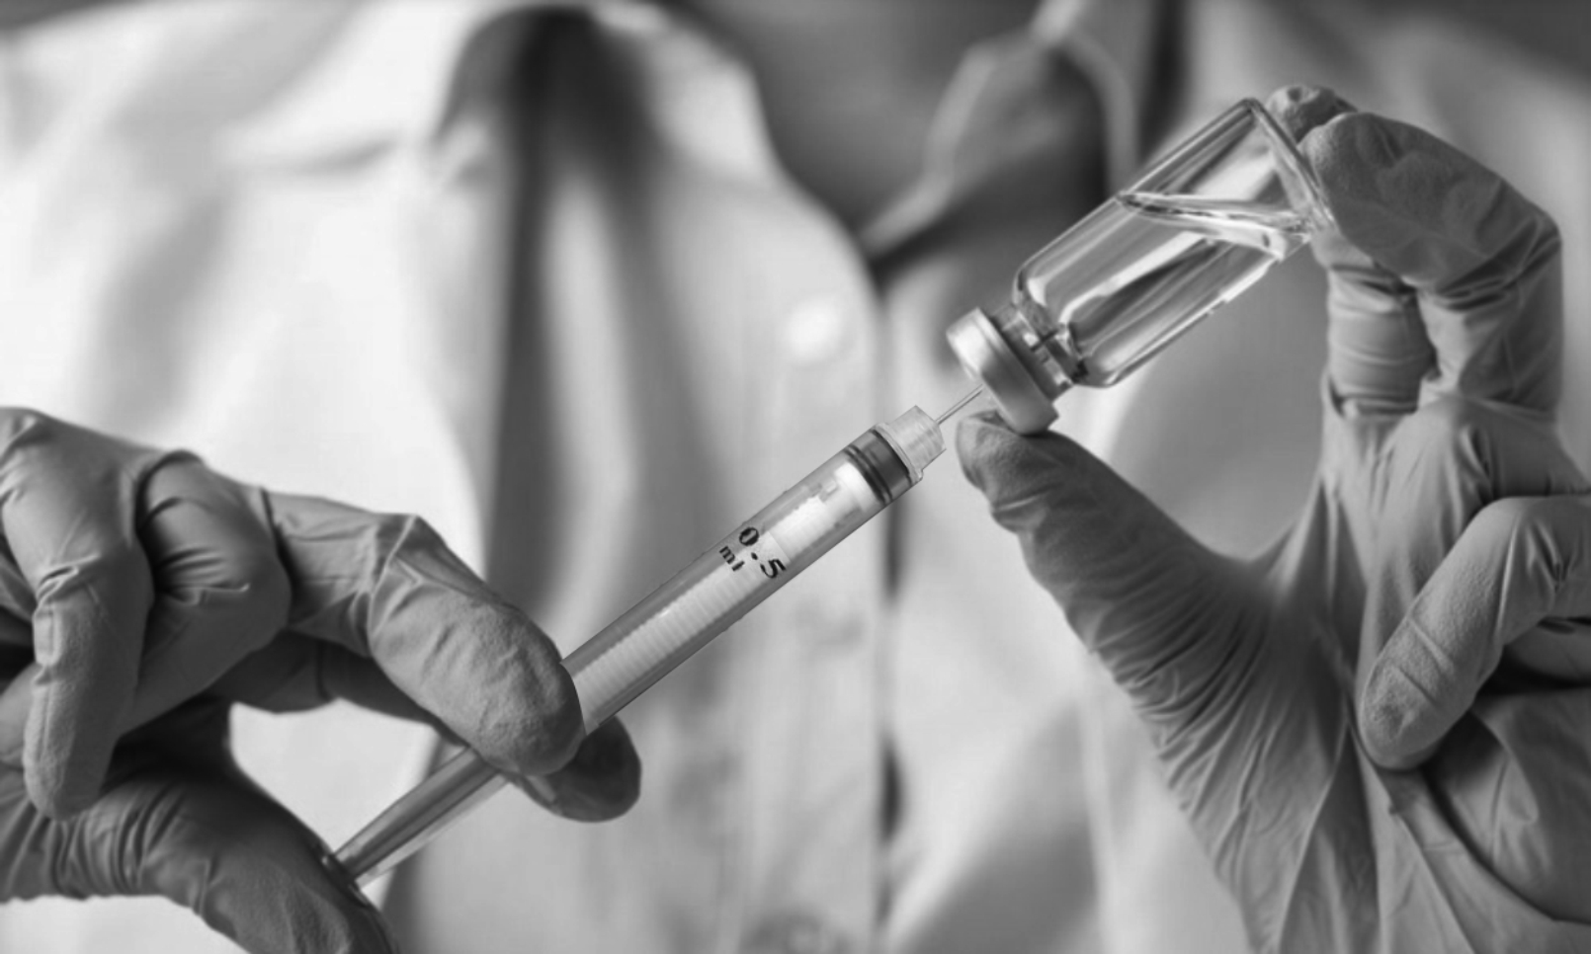




Vaccination Session,
Vaccine Cold Chain & Immunization Waste Management at Session Sites

Slide 26
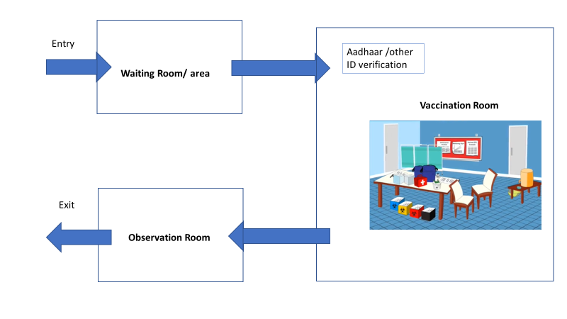
How to set up a vaccination site
Designate a separate entry and exit if possible
Open windows for ventilation
Designate three separate rooms or areas
  Waiting room/ area
  Vaccination Room
  Observation Room/ area
Ensure adequate physical distance between chairs/ seats in waiting rooms
Avoid criss-cross movement of beneficiaries at session site
  Make arrow marks/foot step marks to show directions

Slide 27
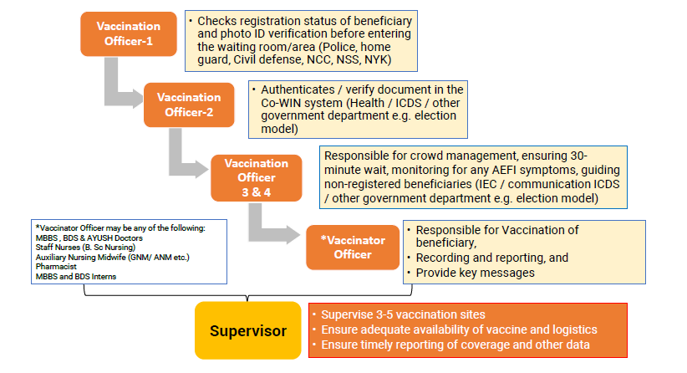
Roles of Vaccination Team Members

Slide 28
Vaccine specifications (Covishield & Covaxin)
Liquid vaccine, intramuscular injection, 2 dose schedule, 0.5 ml per dose,
Covishield- 10 dose vial; Covaxin- 10 dose vial & 20 dose vial
Physical appearance is clear to slightly opaque, colorless to slightly brown
Recommended storage temperature is +2 to +8 Deg C
Shake test is not applicable;
Freeze sensitive vaccines
No VVM on the vial
Open Vial Policy is not applicable, Mention date/ time on vial immediately after opening- Discard after 4 hours
Ensure Early Expiry First out (EEFO)

Slide 29
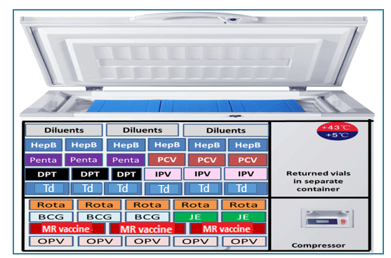
COVID vaccine storage in ILR and domestic refrigerator
COVID vaccine

Slide 30
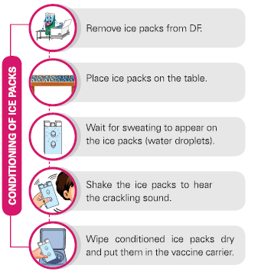
Ice pack conditioning

Slide 31
COVID Vaccination at health facility
Private facility should have ILR or Refrigerator for exclusively storing vaccines
There should be uninterrupted power supply/ power back-up
With temperature monitoring device and temperature chart-twice daily recording
COVID vaccine vial should not be used beyond 4 hours of opening under any circumstances.
Mention date/time on vial immediately after opening
Use a new syringe for every vaccination
Never place partially used/open vials in an ILR/refrigerator

Slide 32
COVID Vaccination at health facility
Every beneficiary should wait for 30 minutes after vaccination at the facility to observe for any immediate AEFI
AEFI management kit/Anaphylaxis kit should be present at the CVC
Every AEFI should be reported on Co-WIN and serious AEFI should be immediately intimated to RCHO
Strict injection safety precautions to be maintained
Waste disposal as per standard guidelines

Slide 33
Management during COVID Vaccination session at CVCs
Ensure that the vaccine from same manufacturer is administered to the beneficiary for 2nd dose
Never expose the vaccine carrier, vial or icepack to direct sunlight
All vaccines should be kept inside the vaccine carrier/ refrigerator with the lid/ door closed until a beneficiary comes for vaccination
Keep the COVID vaccine on the table and not on the ice pack
Never pre-fill syringes
All open vaccine vials need to be discarded after 4 hours of opening or at the end of session – date and time of opening of vials needs to be written on the vial
Use all vaccine contents in a vial before opening a new vial.

Slide 34
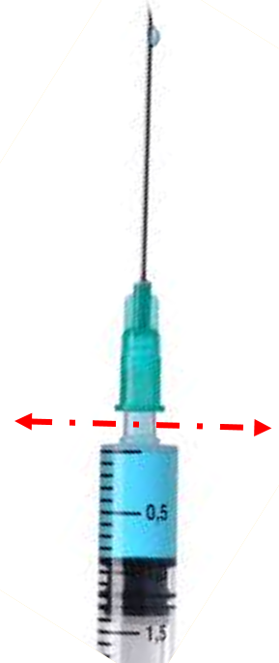
Steps to ensure safe disposal of immunization waste at session sites
(public and private sector)
Step 1: At the session site, vaccinators cut the hub of the AD syringe immediately after administering the injection using the hub cutter. The cut needles will get collected in the puncture-proof container of the hub cutter
Step 2: Segregate and store the plastic portion of the cut syringes in the red bag or container. The bags/ container should bear the biohazard symbol
Step 3: Store the broken vaccine vials in a separate blue container, used cotton swab in the yellow bag

Slide 35
Steps to ensure safe disposal of immunization waste at session sites (public and private sector)
Step 4: Plastic wrapper, cap of the syringe, PCM wrappers and any other packaging material should be segregated as general waste
Step 5: The used and unused vaccine vials should be returned to the CCP as per existing AEFI guidelines for proper disposal
Step 6: At the end of the session- send the Red bag, Yellow bag, Blue bag/container and the hub cutter to CCP for further disinfection and disposal or handing over to Common Biomedical Waste Treatment Facility (CBWTF)
Note-
General Waste Bag may be of any colour and will not carry biohazard symbol
In case of disposal of face mask, PPE etc. at session, protocol for COVID-19 waste management July 2020 should be followed

Slide 36
Adverse Event Following Immunization (AEFI)

Slide 37
AEFI: DEFINITION
“An adverse event following immunization (AEFI) is any untoward medical occurrence which follows immunization, and which does not necessarily have a causal relationship with the usage of the vaccine.
The adverse event may be any unfavorable or unintended disease, symptom, sign or abnormal laboratory finding.”

Slide 38
TYPES OF AEFI FOR REPORTING
For purpose of reporting, AEFIs can be minor, severe and serious.
Minor AEFI | Severe AEFI | Serious AEFI
Common, self limiting reactions Examples: pain, swelling at injection site, fever, irritability, malaise etc. | Can be disabling and rarely life threatening do not lead to long-term problems Examples of severe reactions include non-hospitalized cases of anaphylaxis that has recovered, high fever (>102-degree F), etc. | Results in death Requires inpatient hospitalization Results in persistent or significant disability AEFI cluster Evokes significant parental/community concern

Slide 39
Preventable AEFIs
Anxiety reactions:
Vaccinations occur in comfortable, well-ventilated and airy settings.
Beneficiaries waiting to be vaccinated do not interact with those who have been vaccinated.
Beneficiaries who seem anxious or nervous should be calmed down or their attention diverted from the process and the pain.
After vaccination, if they feel light-headed or giddy, they should be asked to lie down for some time.
Immunization errors:
Strictly adhere to safe injection practises and maintain cold chain at session site
Use separate AD syringes for each vaccination
Check vaccine vial labels before loading the syringe
Beneficiaries are screened for contraindications
Other specific precautions as per guidelines issued for specific vaccines

Slide 40
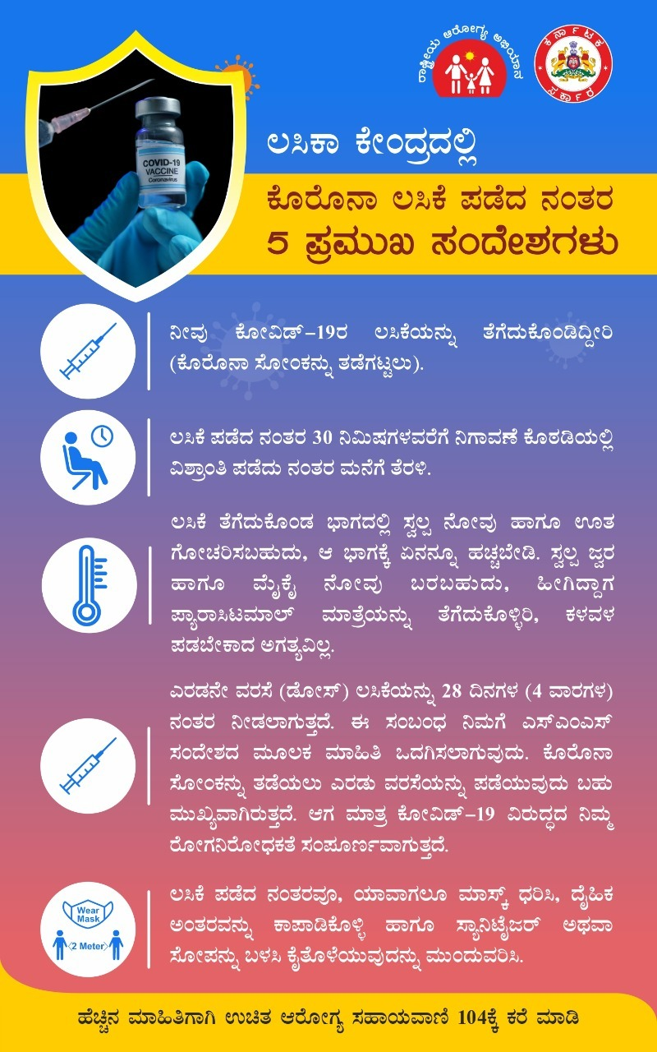
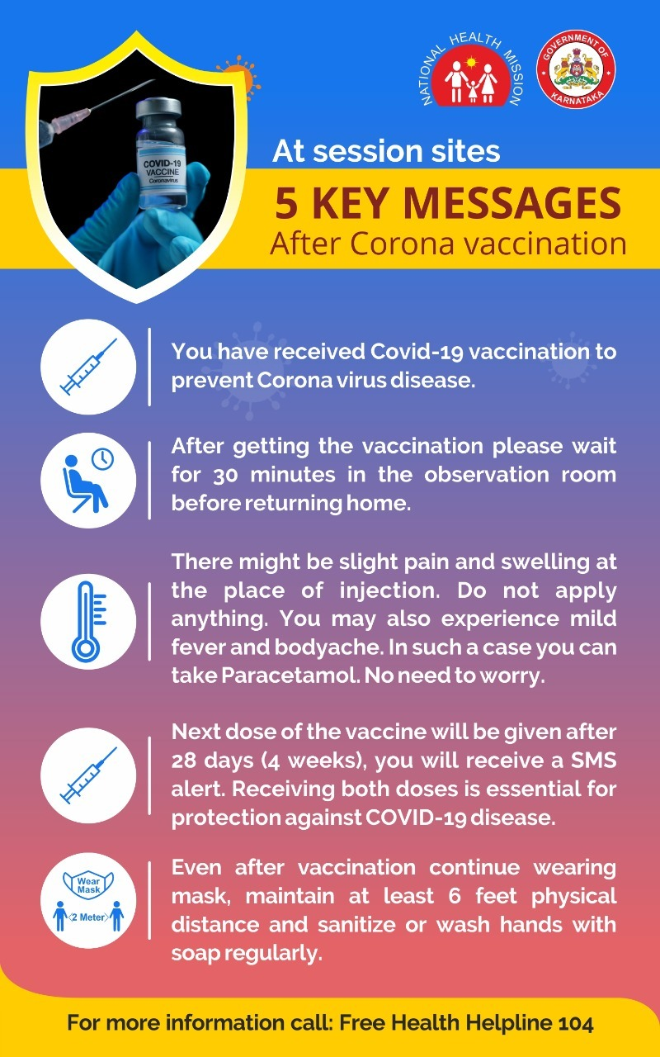
5 Key Messages

Slide 41
MANAGING AEFI
Ensure all vaccine recipients wait at the session site for 30 minutes after vaccination
After vaccination, inform the vaccine recipient
  About minor events which may occur - mild to moderate fever, local pain and swelling at injection site, malaise etc.
    Tablet Paracetamol SOS with a minimum interval of 6 hours between two doses
    Visit nearest health facility, if minor adverse event persists beyond 2-3 days
  For any other severe / serious event, immediately refer to a secondary or tertiary care health facility
An anaphylaxis kit with injection adrenaline within expiry date should be available at the outreach session site
Use anaphylaxis kits available at the session site for immediate management of suspected anaphylaxis.
Contact numbers of ambulance services should be available with the vaccinator team (102, 108 etc)

Slide 42
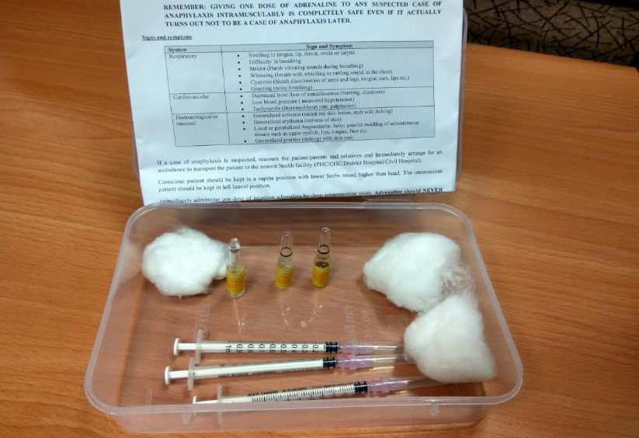
Initial management of Anaphylaxis
Suspected anaphylaxis:
Early onset and rapid progression of symptom
at least one sign/symptom related to at least two of the following three systems
  respiratory (swelling of tongue, lip, throat; noisy breathing or difficulty in breathing with harsh sounds/whistling/rattling sound in chest, bluish discoloration of arms and legs, tongue, ears, lips, etc.)
  cardiovascular (fainting, decreased level /loss of consciousness, low blood pressure, increased heart rate, palpitation)
  dermatological/mucosal (skin-related like raised red skin lesion, rash with itching over body, itchy/ painful swelling of subcutaneous tissues such as upper eyelids, lips, tongue, face etc.)
Figure 2: Anaphylaxis Kit with instructions manual

Slide 43
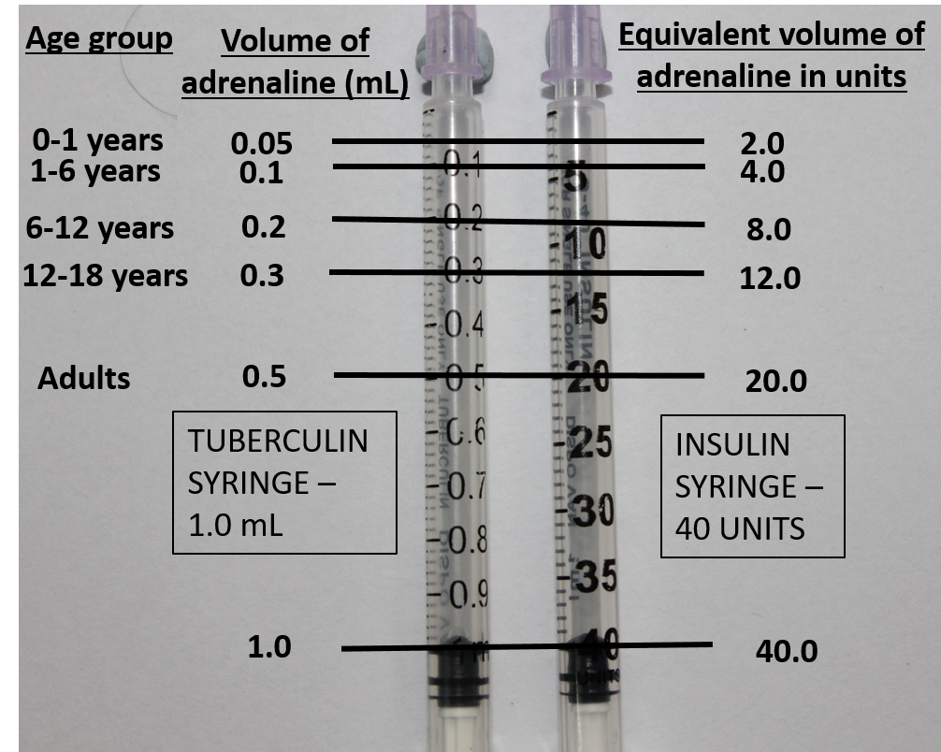
Initial management of Anaphylaxis
Adrenaline is the drug of choice to treat anaphylaxis
Age (in years) | Needle for intramuscular injection | Age specific dose of adrenaline (1:1000) in ml (tuberculin) or units (insulin)
Adults | 1 inch long of 24G or 25G | 0.5 ml / 20 units
12-18 |  | 0.3 ml / 12 units
6-12 |  | 0.2 ml / 8 units
1-6 |  | 0.1 ml / 4 units
0-1 |  | 0.05 ml / 2 units
Table1: Age specific dose of Adrenaline
Figure 3: Markings of age-appropriate dosage of adrenaline in mL (tuberculin syringes) and equivalent volume in units (insulin syringes)

Slide 44
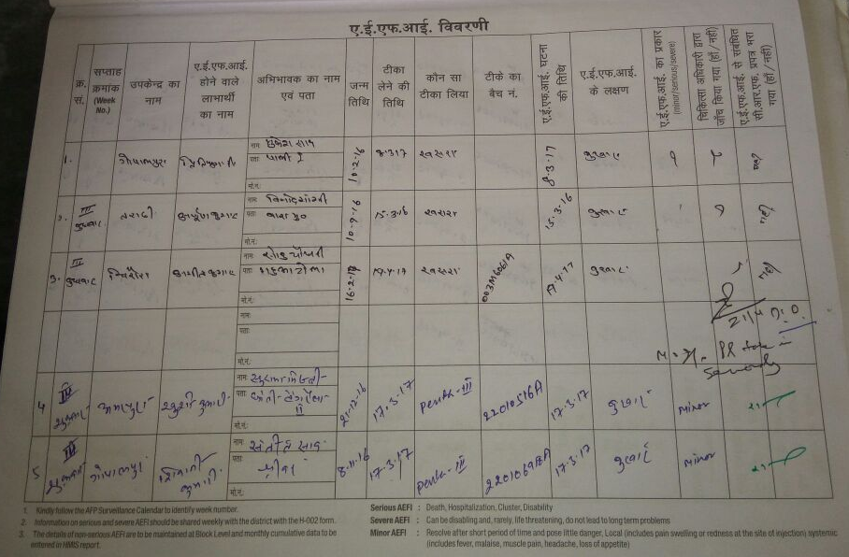
Recording of AEFI
Immediate Reporting: all serious and severe AEFIs to the supervisor and medical officer
Co-WIN: all (minor, severe and serious) adverse events, against the respective beneficiary names
AEFI registers: all (minor, severe and serious) adverse events in the AEFI register
AEFI recording register
Reporting and investigation of cluster AEFI cases
Cluster: two or more cases of the same adverse event related in time, place or vaccine administered
Immediately inform the supervisor and medical officer

Slide 45
AEFI Reporting:
Any case of hospitalization or death of a COVID positive (RT-PCR /CBNAAT/HRCT confirmed) case who has received atIeast one dose of vaccine before getting infected should be reported as a serious AEFI on Co-WIN.
Reporting of any serious,/severe adverse event occurring beyond one week of vaccination up to at least 28 days of COVID-19 vaccination should be encouraged
States to ensure regular State AEFI committee meetings are held and causality assessment of the reported serious/severe AEFI cases is completed as per the National COVID-I9 guidelines.

Slide 46
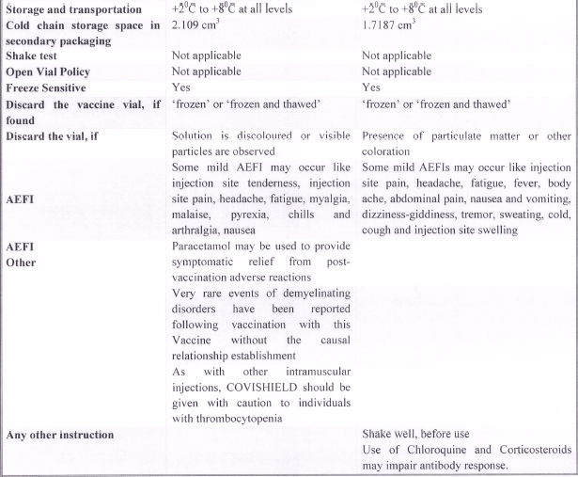
46

Slide 47
Statement of the WHO Global Advisory Committee on Vaccine Safety (GACVS) COVID-19 subcommittee on safety signals related to the AstraZeneca COVID-19 vaccine
19 March 2021 Statement
Based on a careful scientific review of the available information, the subcommittee came to the following conclusions and recommendations:
The AstraZeneca COVID-19 vaccine (including Covishield) continues to have a positive benefit-risk profile, with tremendous potential to prevent infections and reduce deaths across the world.
The available data do not suggest any overall increase in clotting conditions such as deep venous thrombosis or pulmonary embolism following administration of COVID-19 vaccines. Reported rates of thromboembolic events after COVID-19 vaccines are in line with the expected number of diagnoses of these conditions. Both conditions occur naturally and are not uncommon. They also occur as a result of COVID-19. The observed rates have been fewer than expected for such events.
While very rare and unique thromboembolic events in combination with thrombocytopenia, such as cerebral venous sinus thrombosis (CVST), have also been reported following vaccination with the AstraZeneca COVID-19 vaccine in Europe, it is not certain that they have been caused by vaccination. The European Medicines Agency’s Pharmacovigilance and Risk Assessment Committee has reviewed 18 cases of CVST out of a total of more than 20 million vaccinations with the AstraZeneca COVID-19 vaccine in Europe. A causal relationship between these rare events has not been established at this time

Slide 48
Statement of the WHO Global Advisory Committee on Vaccine Safety (GACVS) COVID-19 subcommittee on safety signals related to the AstraZeneca COVID-19 vaccine
19 March 2021 Statement
Based on a careful scientific review of the available information, the subcommittee came to the following conclusions and recommendations:
Adequate education should be provided to health-care professionals and persons being vaccinated to recognize the signs and symptoms of all serious adverse events after vaccinations with all COVID-19 vaccines, so that people may seek and receive prompt and relevant medical care and treatment.
The GACVS subcommittee recommends that countries continue to monitor the safety of all COVID-19 vaccines and promote reporting of suspected adverse events.

Slide 49
COVID Vaccination
(Precautions and Contraindications)

Slide 50
Precautions and Contraindications for COVID-19 Vaccination
Authorised Age Group: Under the EUA, COVID-19 vaccination is indicated only for 18 years and above
Co-administration with other vaccines: If required, COVID-19 vaccine and other vaccines should be separated by an interval of at least 14 days
Inter-changeability of COVID-19 vaccines: is not permitted. Second dose should also be of the same COVID-19 vaccine which was administered as the first dose
50

Slide 51
Contraindications
Persons with history of:
  Anaphylactic or allergic reaction to a previous dose of COVID-19 vaccine
  Immediate or delayed-onset anaphylaxis or allergic reaction to vaccines or injectable therapies, pharmaceutical products, food-items, etc.
Pregnancy and Lactation:
  Pregnant and Lactating women have not been part of any COVID-19 vaccine clinical trial so far. Therefore women who are pregnant or not sure of their pregnancy and lactating women should not receive COVID-19 vaccine at this time
51

Slide 52
Provisional/ Temporary Contraindications:
In these conditions, COVID-19 vaccination is to be deferred for 4-8 weeks after recovery
Persons having active symptoms of SARS-CoV-2 infection
SARS-CoV-2 patients who have been given anti-SARS-CoV-2 monoclonal antibodies or convalescent plasma
Acutely unwell and hospitalised (with or without intensive care) patients due to any illness
52

Slide 53
Special Precautions
Special Precautions:
Vaccine should be administered with caution in persons with history of any bleeding or coagulation disorder
(e.g. clotting factor deficiency, coagulopathy or platelet disorder)
53

Slide 54
Kindly note: Vaccine can be given in these conditions
Following conditions are not contraindicated for COVID vaccines
  Persons with a past history of SARS-CoV-2 infection (sero-positivity) or RT-PCR positive illness
  History of chronic diseases and morbidities (cardiac, neurological, pulmonary, metabolic, renal, malignancies)
  Immunodeficiency, HIV, patients on immune-suppression due to any condition (the response to the COVID-19 vaccines may be less in these individuals)
Other Important Issues to consider:
  Vaccine specific contraindications may apply as the new information becomes available
54

Slide 55
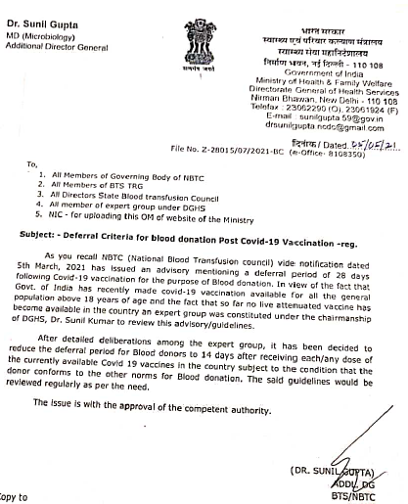
Deferral criteria for blood donation
Post Covid-19 vaccination
MoHFW-DGHS, GOI: 5th May 2021
After detailed deliberations among the expert group, it has been decided to reduce the deferral period for blood donors to 14 days after receiving each/any dose of the currently available COVID-19 vaccines in the country subject to the condition that the donor conforms to the other norms of blood donation
The said guidelines would be reviewed regularly as per the need

Slide 56
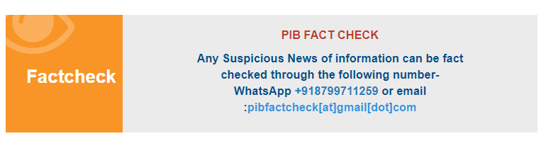
Press Information Bureau -Factcheck

Slide 57


Slide 58
What impact do the new variants of the COVID-19 virus have on vaccines?
The COVID-19 vaccines that are currently in development or have been approved are expected to provide at least some protection against new virus variants because these vaccines elicit a broad immune response involving a range of antibodies and cells.
Therefore, changes or mutations in the virus should not make vaccines completely ineffective
Data continues to be collected and analysed on new variants of the COVID-19 virus.
This is an area where the evidence remains preliminary and is developing quickly.

Slide 59
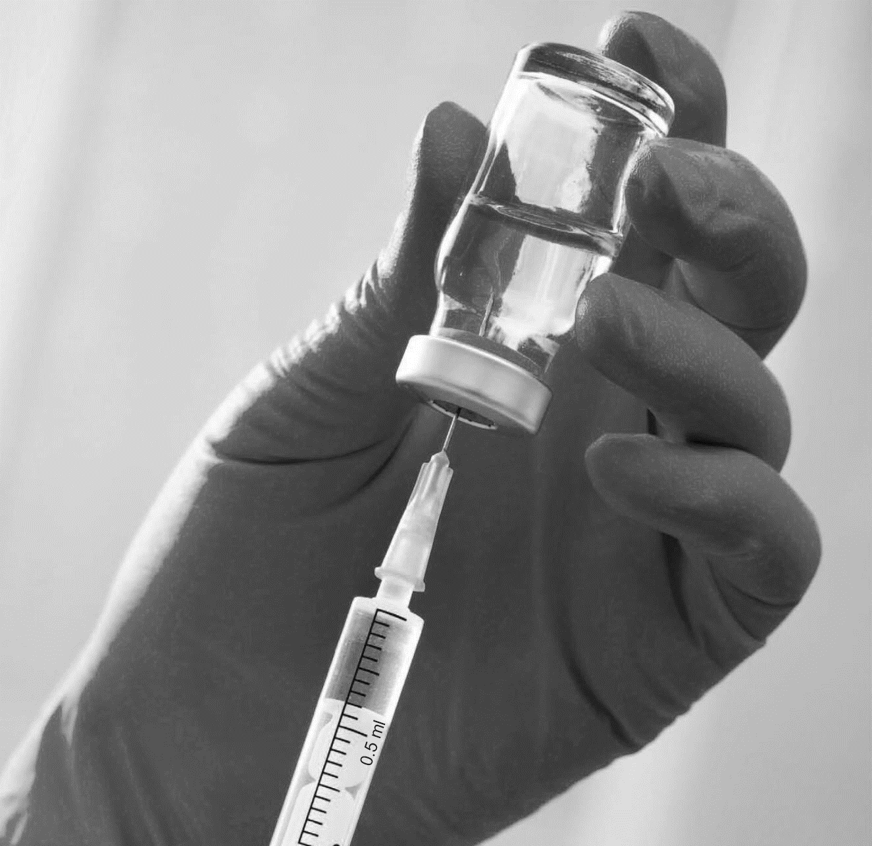
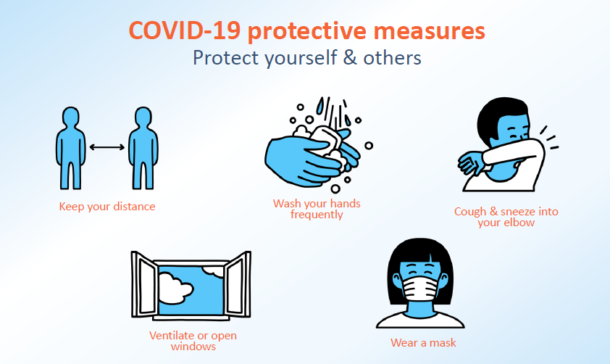
Thank You

Slide 60
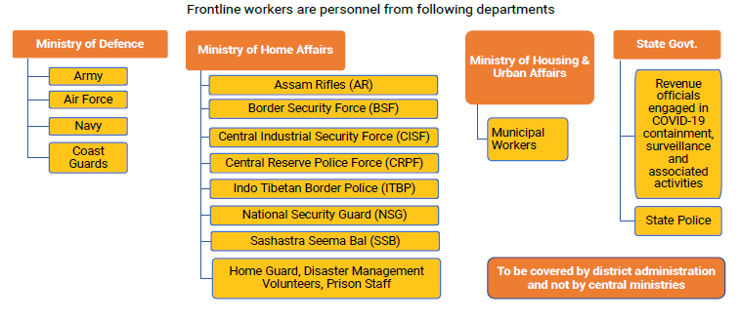
Frontline Worker Categories

Slide 61
